Slide 1
CIS8695 Managing Big Data Analytics
Nasim Mousavi
Assistant Professor
J. Mack Robinson College of Business
Georgia State University
nmousavi@gsu.edu

Slide 2
Announcements
HW1 will be posted tomorrow, and will be due on Wednesday August 30th before the class (5:30 PM)
Delayed submission will result in score deduction
Group team selection and proposal are due on September 6th at 11:59 PM
I created a section for group project in iCollege with a google form, please submit your project information there
In-class exercises need to be uploaded in iCollege by the end of the class
Delayed submission will not be accepted

Slide 3
What We Have Learned!

Slide 4
What Is Classification?
Classification is used to identify a class or category from a set of categories
Predict a class of a previously unseen record
From among a set of established variables, the algorithm is able to recognize to which category a new variable belongs to.

Slide 5
Catching Tax-Evasion
Tax-return data for 2011, and we want to predict whether a person is a cheater or not in 2012
A new tax return for 2012
Is this a cheating tax return?

Slide 6
What Is Classification?
categorical
categorical
continuous
class
One of the attributes is the dependent variable
In this case: Cheat
Two class labels (or classes): Yes (1), No (0)

Slide 7
Examples of Classification Tasks
Predicting tumor cells as benign or malignant
Classifying credit card transactions as legitimate or fraudulent
Categorizing news stories as finance, weather, entertainment, sports, etc.
Identifying spam email, spam web pages, adult content
Understanding if a web query has commercial intent or not

Slide 8
General Approach to Classification
Training set consists of records with known class labels
Training set is used to build a classification model
A labeled test set of previously unseen data records is used to evaluate the quality of the model.
The classification model is applied to new records with unknown class labels

Slide 9
Illustrating Classification Task

Slide 10
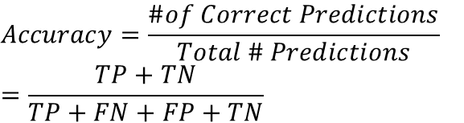
Evaluation of Classification Models
Counts of test records that are correctly (or incorrectly) predicted by the classification model
Confusion matrix
$$Accuracy=\frac{\#of Correct Predictions}{Total \# Predictions}=\frac{TP+TN}{TP+FN+FP+TN}$$
 | PREDICTED CLASS
Actual |  | Yes | No
 | Yes | a (TP) | b (FN)
 | No | c (FP) | d (TN)

Slide 11
ROC (Receiver Operating Characteristic)
ROC curve plots TPR (on the y-axis) against FPR (on the x-axis)
 | PREDICTED CLASS
Actual |  | Yes | No
 | Yes | a (TP) | b (FN)
 | No | c (FP) | d (TN)
Fraction of positive instances predicted correctly
Fraction of negative instances predicted incorrectly

Slide 12
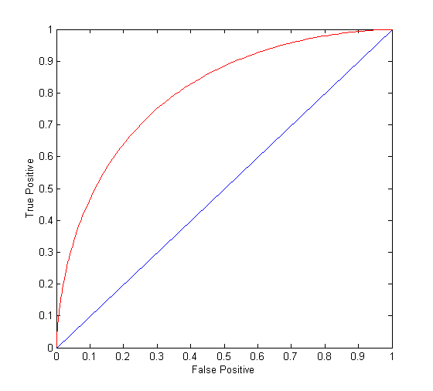
ROC Curve
(TP,FP):
(0,0): declare everything to be negative class
(1,1): declare everything to be positive class
(1,0): ideal
Diagonal line:
Random guessing
 | PREDICTED CLASS
Actual |  | Yes | No
 | Yes | a (TP) | b (FN)
 | No | c (FP) | d (TN)

Slide 13
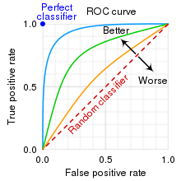
Area Under the Curve
Area Under the ROC curve (AUC)
Ideal: Area = 1
Random guess:
Area = 0.5

Slide 14
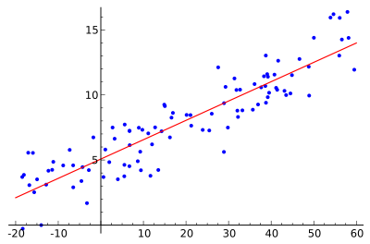
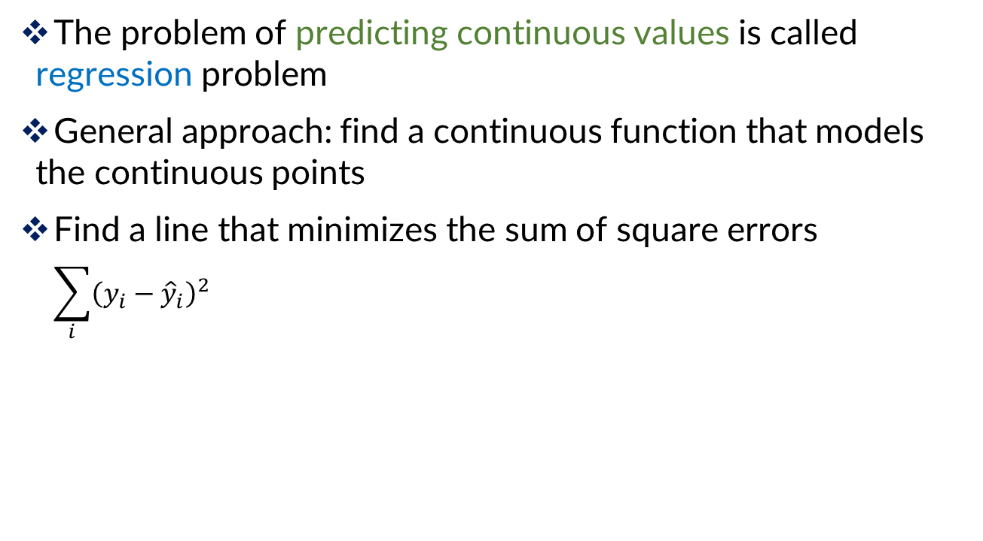
Linear Regression
The problem of predicting continuous values is called regression problem
General approach: find a continuous function that models the continuous points
Find a line that minimizes the sum of square errors
$$\sum_{i}{{\left(y_{i}−{\hat{y}}_{i}\right)}^{2}}$$

Slide 15
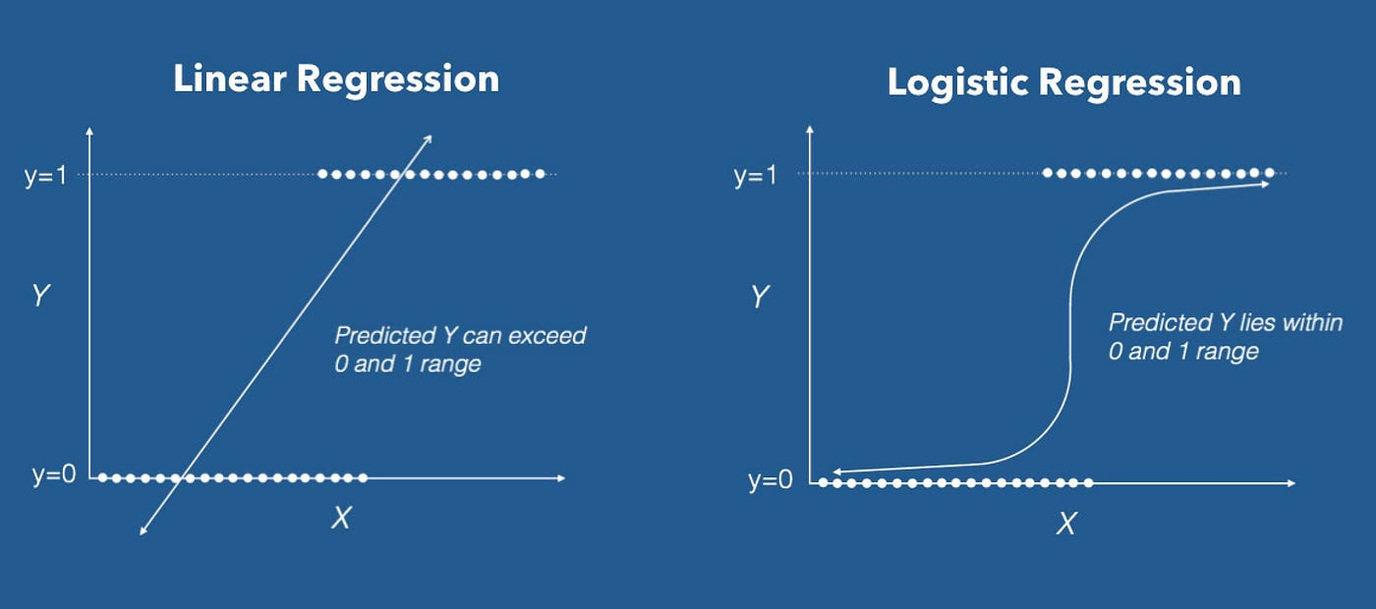
Logistic Regression
The dependent variable is binary (Y=0 or Y=1)
Linear regression is not suitable
Instead of predicting the class of a record we want to predict the probability of the class given the record

Slide 16
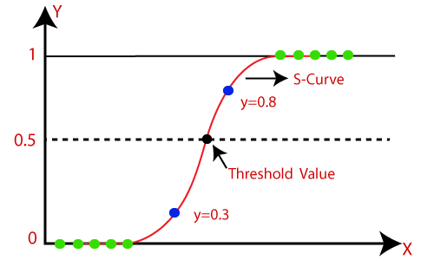
Logistic Regression

Slide 17

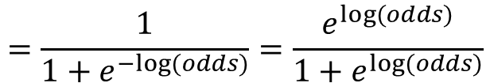

Logistic Regression
Logistic function
$p:probability of belonging to a class$
Rewrite:
Linear regression on the log-odds ratio
$$=\frac{1}{1+e^{−log⁡(odds)}}=\frac{e^{log⁡(odds)}}{1+e^{log⁡(odds)}}$$
$$Log\left(Odds\right)=$$

